Slide 1
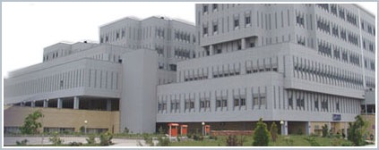
Update on Management of Refractory Overactive bladder: Nerve stimulation
Sakineh Hajebrahimi, MD
Professor of Urology & Neurourology Department, Research center for EBM, TUMS, Tabriz, Iran

Slide 2
Terminology
Neurogenic OAB and DO
NLUTD
Overactive bladder (OAB)
A symptomatic diagnosis defined as urinary urgency, usually with daytime frequency or/and nocturia with urinary incontinence(OAB wet), or without(OAB dry), in the absence of urinary infection or any other detectable disease.
Q
Detrusor overactivity (DO) A urodynamic observation characterized by involuntary
detrusor contractions (IDC) during the filling phase
pdet
pves
pabd
Haylen BT, et al. Neurourol Urodyn. 2010;29:4-20.
Sahai A, et al. Expert Opin Pharmacother. 2006;7(5):509-527.

Slide 3
Treatment Priority
1. Protection of the upper urinary tract
2. Improvement of urinary continence
3. Restoration of (parts of) the LUT function
4. Improvement of the patient’s quality of life.

Slide 4
Current treatments for Overactive Bladder
Behavioral therapies & Physical Therapy
Drugs: anticholinergic, B3- Agonists
Minimally invasive interventions
Intravesical Botox
Neurostimulation: Sacral, PTNS
Surgery
Augmentaton cystoplasty
Urinary diversion
AUA/SUFU OAB Guidelines 2019
EAU Female LUTS Guideline 2021
Notes:
[Overview of Voiding Dysfunction, Slides 4-11]
Treatment plan moves from non-invasive (behavioral), to minimally invasive (electrical stimulation), to highly invasive (surgery).
First choice of treatment should be least invasive with fewest potential complications.
Behavioral techniques include toileting assistance, bladder retraining, pelvic muscle rehabilitation, and dietary changes (AHCPR, 1996).
Behavioral techniques may decrease the frequency of urge incontinence when provided by knowledgeable health care providers, have no reported side effects, and do not limit future treatment options.
Pharmacologic treatments for urge incontinence and urgency-frequency can include anticholinergic agents, tricyclic antidepressants, antispasmodic agents and antimuscarinic agents.
Interventional therapies for urgency-frequency include instillation; vaginal and anal external stimulation and InterStim® test stimulation.
Surgery can include: InterStim® Therapy (sacral nerve stimulation); augmentation enterocystoplasty or urinary diversion; bladder dennervation.
NAFC – National Association for Continence (patient advocacy group).

Slide 5
EAU Female LUTS Guideline 2021

Slide 7
How Likely Are Patients To Continue With Their Drug Therapy?
Prescription persistency rates of OAB medications
among patients new to market (n=21,362)
56% of patients chose not to refill their prescription a second time
Only 15% of patient continued with their therapy through the first year

Slide 8
Nerve Stimulations

Slide 9
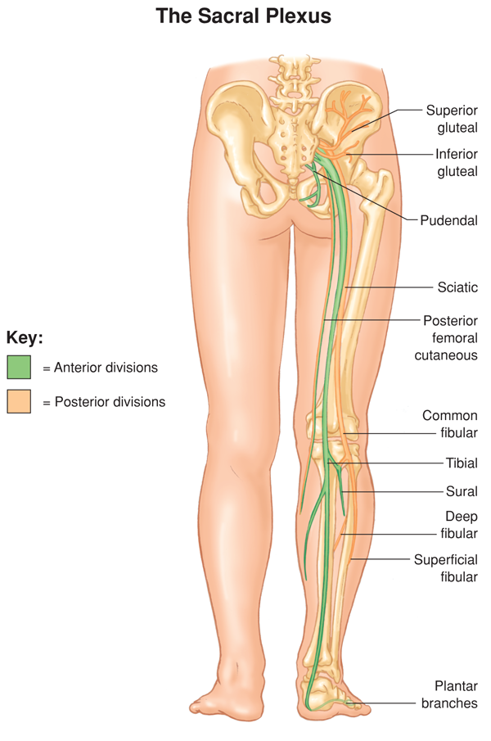
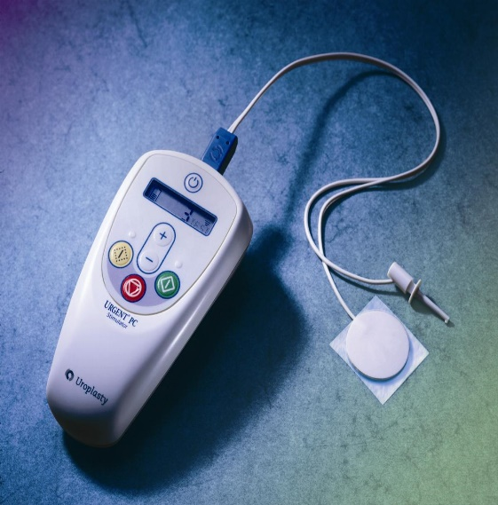
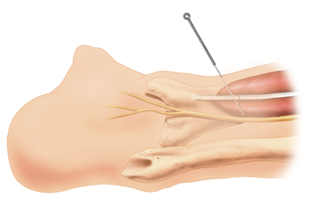
Percutaneous Tibial Nerve Stimulation

Slide 10
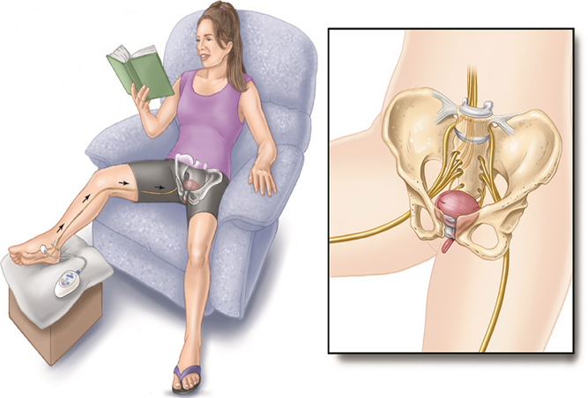
PTNS: SUmiT Trial
Study of Urgent PC vs Sham Effectiveness of Treatment of Overactive Bladder Symptoms
Improvement in global response assessment (GRA)
PTNS vs sham: 58.3 vs 21.9%
Response at 12 weeks, not at 6 weeks
Improved QOL, frequency, urgency, UUI, nocturia
Peters KM, et al.: J Urol 2010;183(4):1438-43.

Slide 11
OrBIT trial
Overactive Bladder Innovative Therapy
PTNS versus tolterodine¹
Improvement per GRA:
79.5% vs 54.8%
PTNS vs solifenacin with cross over²
Bladder specific assessment
Both groups showed improvement
¹Peters KM, et al.: J Urol 2009;182(3):1055-61.
²Veccioli-Scaldazza C, et al.: Gyneocol Obstet Invest 2013;75(4):230-4.

Slide 12
STEP Study results
At 36 months 77% had sustained moderate/marked improvement¹
All domains tested
Over 36 months, average 1.1 treatments/month
OrBIT phase 2 similar carryover noted²
¹Peters KM, et al.: J Urol;189(6):2194-2201.
²MacDiarmad SA, et al.: J Urol 2010;183(1):234-40.

Slide 13
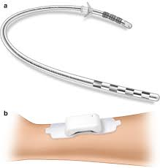
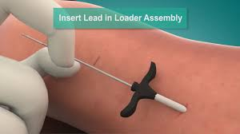
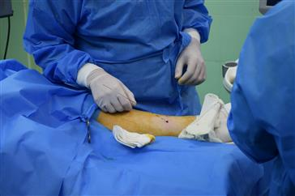
TIBIAL NERVE IMPLANTS (TTNS)

Slide 14
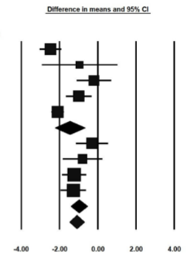
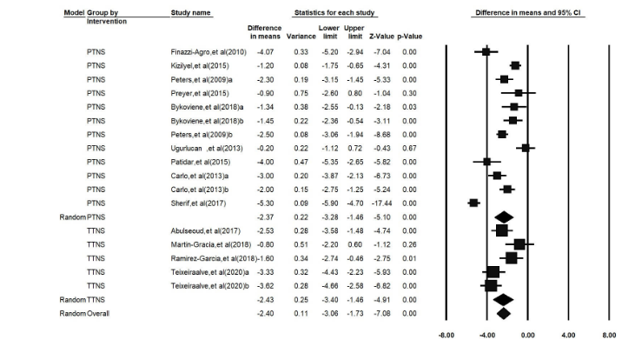
Day time frequency and incontinence episodes
Hajebrahimi et al, 2021

Slide 15
Tibial nerve stimulation in the treatment of overactive bladder syndrome: technical features of latest applications
te Dorsthorst, Manon; van Balken, Michael; Heesakkers, John
Current Opinion in Urology30(4):513-518, July 2020.
doi: 10.1097/MOU.0000000000000781
we can conclude the ideal implant is not yet found. Demonstration of the safety and efficacy on the long-term and in larger scale trials is needed

Slide 16
SACRAL NEUROMODULATION

Slide 17
EAU Female LUTS Guideline 2021

Slide 18
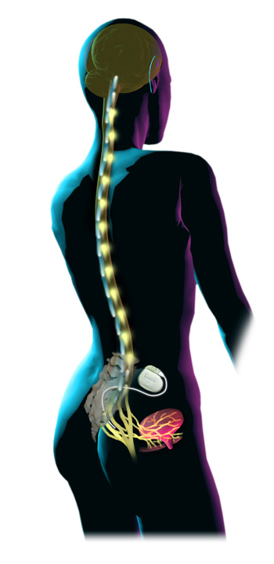
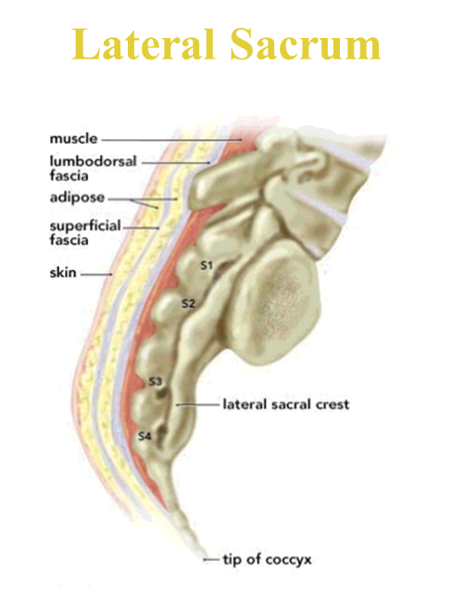
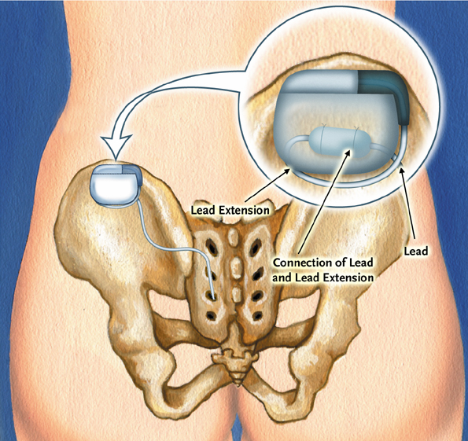
SNM - Therapy
Definition:
An implantable system that stimulates the sacral nerves modulating the neural reflexes that influence the bladder, sphincter, and pelvic floor.
Notes:
Sacral nerve stimulation utilizes an implantable system that stimulates the sacral nerves modulating the neural reflexes that influence the bladder, sphincter and the pelvic floor. There are specific FDA approved indications for the use of sacral nerve stimulation therapy, such as non-obstructive urinary retention urinary retention and the symptoms of overactive bladder, including urinary urge incontinence and significant symptoms of urgency frequency in patients who have failed or can not tolerate more conservative therapies.

Slide 19
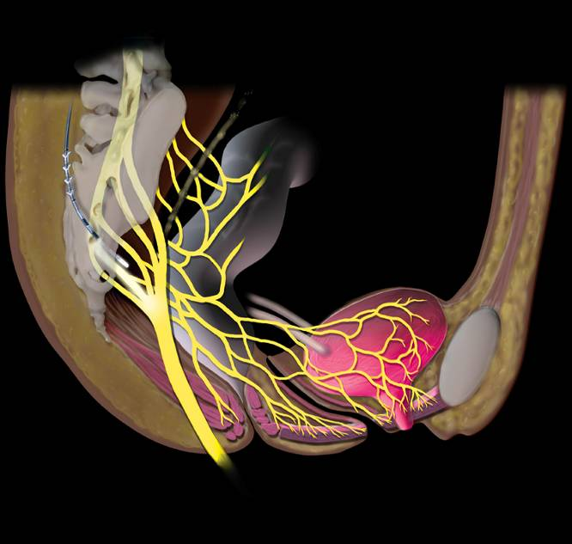
Mechanism of Action
Not a bladder specific therapy
Central afferent modulation
Targets reflex centers in cord and pons
Treats both OAB and retention
Blocks ascending sensory pathway inputs
Turns on voiding reflexes by suppressing the guarding reflex pathways
Leng WW - Urol Clin North Am - 01-FEB-2005; 32(1): 11-8

Slide 20
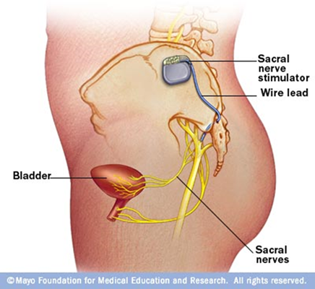
All inclusive!!!
Urinary retention
Overactive bladder (OAB),
Painful bladder syndrome
Fecal incontinence
Sexual function improves
Quality of life improves
Psychosocial outlook
Depression improves
Optimism is not a predictor of success
Long-term safety in Medicare beneficiaries
Banakhar, 2014
Chungtai, 2014, Levin 2014

Slide 21
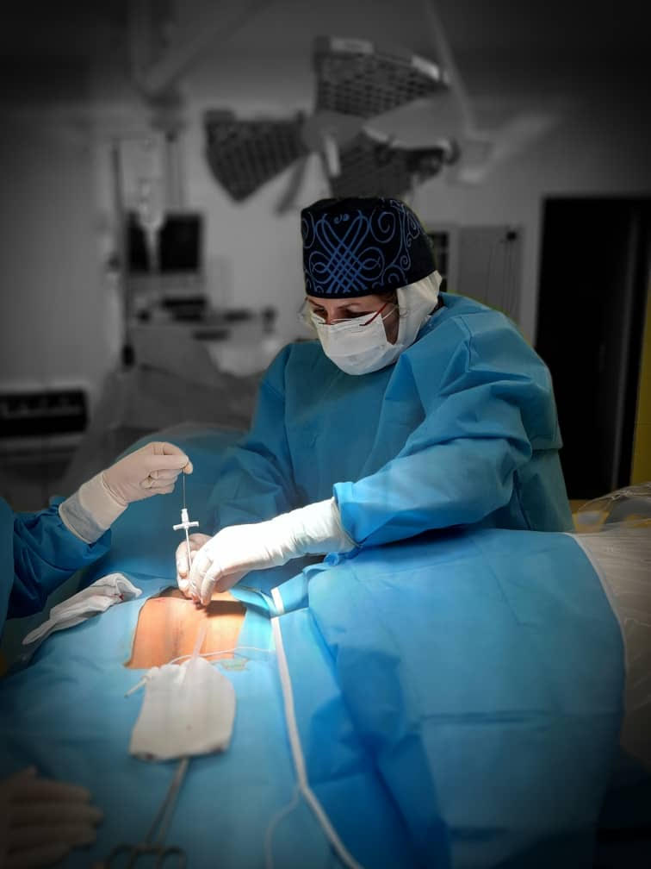
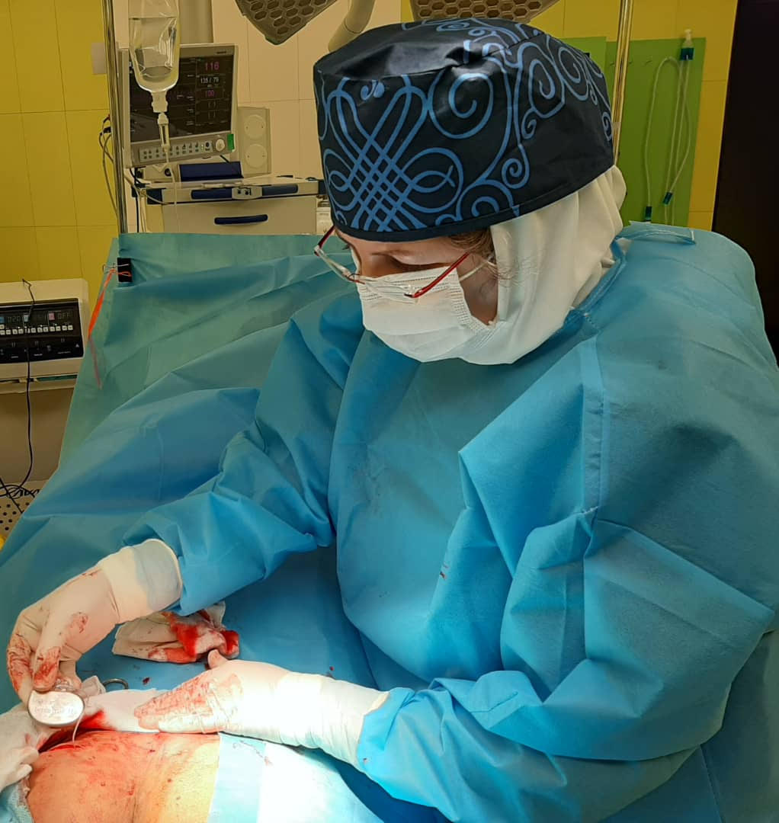
Our experience

Slide 22
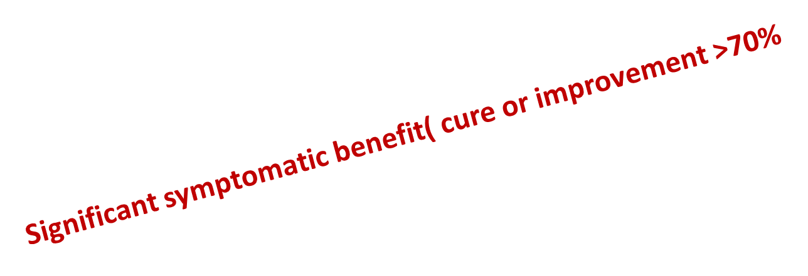
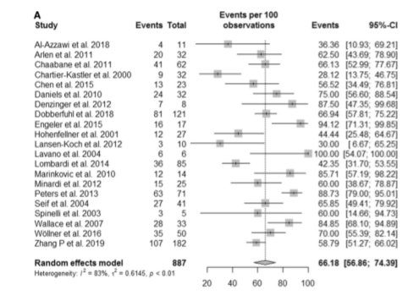
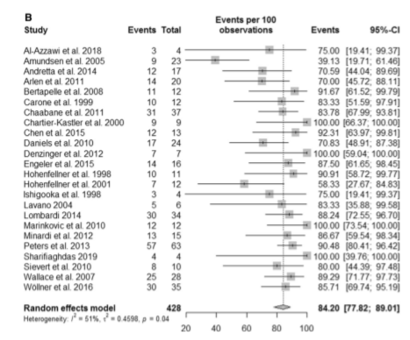
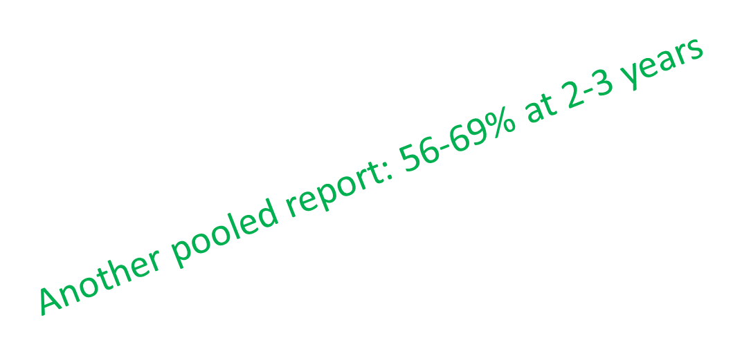
This meta-analysis supports not only the beneﬁts of permanent SNM for various nLUTDs but also high overall success rates, similar to idiopathic patients in over 20 Years’ Experience
Arndt van Ophoven et al 2021
Siddiqui NY, et al.: J Urol 2009;186:2799.
Chartier-Kastler, et al.: BJU Int 2007;101:417

Slide 23
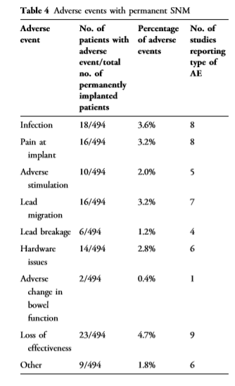
Adverse events
Siddiqui NY, et al.: J Urol 2009;186:2799.
Arndt van Ophoven et al 2021

Slide 24
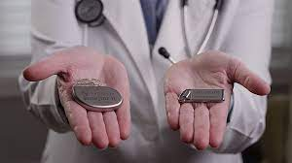
The FDA's approval of Axonics Sacral Neuromodulation System—a system that is MRI-compatible. The FDA has approved the system to treat overactive bladder syndrome as well as fecal incontinence (for similar uses as InterStim from Medtronic).

Slide 25
Cumulative 3-year costs
Treatment | Cost (US $)
PTNS | 7,565
OnabotulinumtoxinA | 11,748
Interstim® | 24,681
Vaginal POP repair | 6,353
Martinson et al.: J Urol 2013 Medicare, CMS

Slide 26
Cost effectiveness
BTX was more cost-effective in 2 years follow up
BTX and SNM similar cost effectiveness in 5 years follow up
JAMA (2016; 316:1366-74).
Siddiqui NY et al, Neurourol Urodyn 2010; 29 Suppl 1: S18

Slide 27
Treatment Options
“Conservative measures”
Pharmacotherapy
Neuromodulation
Electrical or biological
Reconstruction
Augmentation cystoplasty
Urinary diversion
Sling-lysis/urethrolysis

Slide 28
Augmentation cystoplasty / Urinary diversion
Augmentation cystoplasty
Significant morbidity
Urinary diversion
Ileal conduit
Implanting ileum into bladder
Total cystectomy may be indicated with this
Complications
Detrusor myectomy (auto-augmentation)
Denervation, deafferentation, neurostimulation, neuromodulation

Slide 29
The Last Resort…
ENLARGE THE BLADDER!
Bowel segment to enlarge bladder
Lowers intravesical pressure
Increases capacity
>80% must catheterize
A big operation, but…it works!

Slide 30
Augmentation cystoplasty
Current indications
when conservative management, pharmacological methods and minimally invasive treatments have been unsuccessful and exhausted
High satisfaction rates

Slide 31
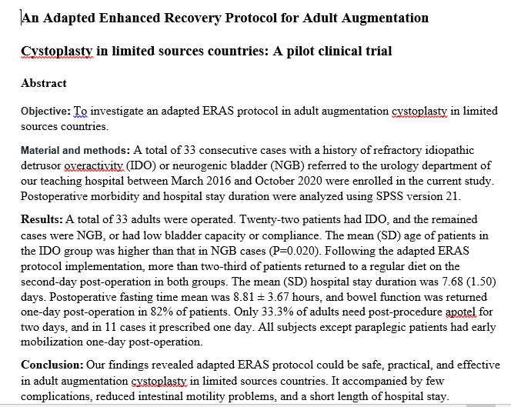

Slide 32
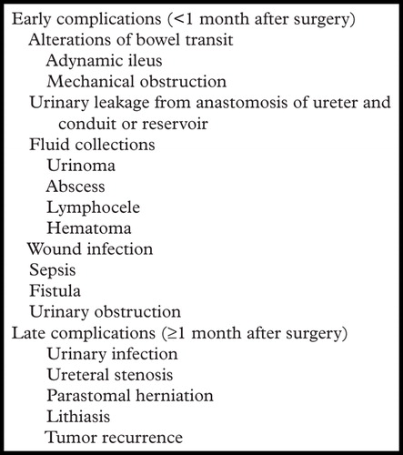
complications

Slide 33
Take home message

Slide 34
Current treatments for Overactive Bladder
Behavioral therapies & Physical Therapy
Drugs, anitcholinergic
Intravesical Botox
Neuromodulation
Sacral
PTNS
Surgery
Augmentaton cystoplasty
Urinary diversion
Notes:
[Overview of Voiding Dysfunction, Slides 4-11]
Treatment plan moves from non-invasive (behavioral), to minimally invasive (electrical stimulation), to highly invasive (surgery).
First choice of treatment should be least invasive with fewest potential complications.
Behavioral techniques include toileting assistance, bladder retraining, pelvic muscle rehabilitation, and dietary changes (AHCPR, 1996).
Behavioral techniques may decrease the frequency of urge incontinence when provided by knowledgeable health care providers, have no reported side effects, and do not limit future treatment options.
Pharmacologic treatments for urge incontinence and urgency-frequency can include anticholinergic agents, tricyclic antidepressants, antispasmodic agents and antimuscarinic agents.
Interventional therapies for urgency-frequency include instillation; vaginal and anal external stimulation and InterStim® test stimulation.
Surgery can include: InterStim® Therapy (sacral nerve stimulation); augmentation enterocystoplasty or urinary diversion; bladder dennervation.
NAFC – National Association for Continence (patient advocacy group).

Slide 35
From a practical standpoint...
 | “Pros” | “Cons”
SNS | Battery life 5-7 years (rechargeable versions) No retention Global effects on pelvic floor | Implanted device Potential complications 2-staged surgery MRIs??? Not for some neurogenic bladder
BTX | Nothing implanted Local anesthesia in office Well-tolerated | Risk of retention Risk of UTI Durability of response

Slide 36
SNM PTNS(TTNS)
Trail Phase 1-2 weeks 12 weeks (no trial time)
Involves surgery/revisions Non invasive (Outpatient)
Implantable No implant possible (small wire)
Takes a lot of expertise Simple to perform(Simple to perform)
Long term efficacy known Still a question
See patients 1x/year Every 3 weeks( every 3 month)
Widely accepted by insurers A work in progress
Expensive Comparatively cheap( overally cheaper)
Reimburses well Not so much
(compatible for MS patients)
(More MRI compatibility)
(very young &elderly)

Slide 37
When to Use BoNT vs. SNM
Neurogenic
Progressive
MRI compatibility
Elderly
Patient willing to perform ISC
No coexisting bowel complaints
Failed SNM
Patient choice
Cost

Slide 38
Take Home Messages
“OAB” multifactorial
Conservative measures first
Stepwise progression
Successful options available (Patients must be made aware)

Slide 39
Any Questions?

